Slide 1
www.gulfresearchinitiative.org
From Response to Coordinated Research
Established 2011

Slide 2
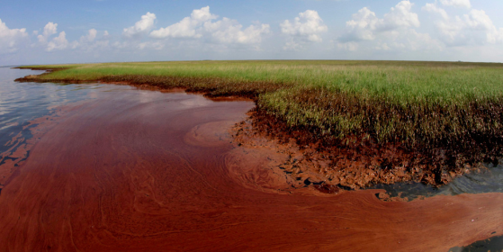
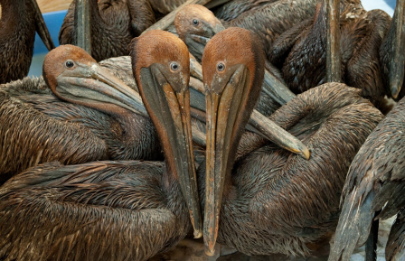
After the Deepwater Horizon oil spill…
GoMRI was established as a broad, independent 10-year research program.
Credit: AP Photo/Charlie Riedel
GoMRI is not part of the Natural Resource Damage Assessment, the Clean Water Act Penalties, the National Academy's Gulf Research Program, or the National Fish and Wildlife Foundation’s Gulf Environmental Benefit Fund.
Credit: SAUL LOEB/AFP/Getty Images

Slide 3
Mission and Goal
MISSION: to implement an independent research program that will
Study the effects of the Deepwater Horizon incident and the potential associated impact of this and similar incidents on the environment and public health and
Develop improvements for spill mitigation, oil detection and characterization, and advanced remediation technologies.
GOAL: to improve society’s ability to understand, respond to and mitigate the impacts of petroleum pollution and related stressors of the marine and coastal ecosystems

Slide 4
Research Themes
PHYSICAL DISTRIBUTION, dispersion, and dissolution of petroleum, its constituents, and associated contaminants under the action of physical oceanographic processes, air-sea interactions, and tropical storms
CHEMICAL EVOLUTION and BIOLOGICAL DEGRADATION of the petroleum/dispersant system and subsequent interactions with coastal, open-ocean, and deep-water ecosystems
ENVIRONMENTAL EFFECTS of the petroleum/dispersant system on the sea floor, water column, coastal waters, beach sediment, wetlands, marshes and organisms, and the science of ecosystem recovery
TECHNOLOGY DEVELOPMENTS for improved response, mitigation, detection, characterization, and remediation associated with oil spills and gas releases
PUBLIC HEALTH impacts of oil spills including behavioral, socioeconomic, environmental risk assessment, community capacity, and other population health considerations and issues

Slide 5
Research Board
Rita Colwell – UMD & JHU
Margaret Leinen – FAU
Debra Benoit – Nicholls State
Peter Brewer – MBARI
Richard Dodge – NOVA SE
John Farrington – WHOI
Kenneth Halanych – Auburn
David Halpern – NASA
William Hogarth – FIO
Raymond Orbach – Tx Austin
Jürgen Rullkötter – University of Oldenburg, Germany
David Shaw – MSU
Rick Shaw – LSU
John Shepherd –University of Southampton, UK
Bob Shipp – South Alabama
Burton Singer – Florida
Ciro Sumaya – Texas A&M
Dennis Wiesenburg – USM
Dana Yoerger – WHOI
Michael Carron – GOMA PD*
Charles Wilson – GOMA CSO*
*Ex Officio

Slide 6
Scientific Integrity
GoMRI uses National Science Board peer evaluation protocols to select funded research
Independent reviews are comprised of scientific peers not affiliated with institutions who lead proposed projects to avoid conflict of interest in the selection of funded research
All reviewers sign conflict of interest and non-disclosure statements
Individual researchers will comply with professional standards as defined by the National Academies of Science
All GoMRI-funded researchers conduct independent and objective work with no influence from BP
Researchers independently publish their results in peer-reviewed scientific journals with no requirement for BP approval

Slide 7
Funded Research to Date = $315.6M
Year One Block Grants - $45M, 149 projects
Bridge Grants (RFP-III, Summer 2011) -$1.5M, 17 projects
Consortia Grants (RFP-I, 2012)- $110.5M, 8 consortia
Investigator Grants (RFP-II, 2013) - $18.6M, 19 projects
Consortia Grants (RFP-IV, 2015) - $140M, 12 consortia
As of May 2015:
>550 scientific peer-reviewed publications
>2200 scientific presentations and posters
~680 graduate students

Slide 8
Grants Distribution

Slide 9
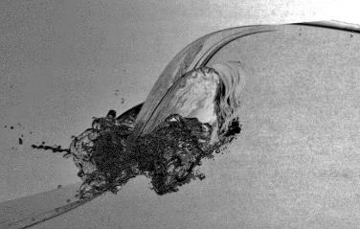
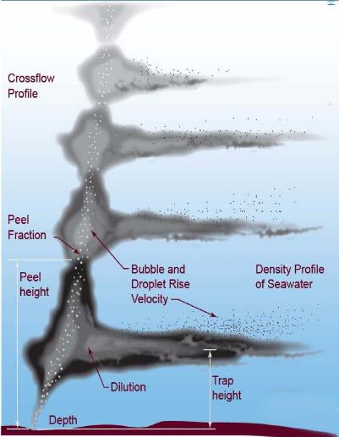
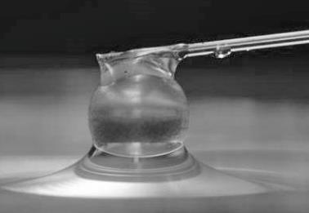
Fine-Scale Oil Behavior
Notes:
In other areas, here are some examples to give you a brief idea of the work that’s been underway…
Two of our consortia (C-MEDS & DROPPS) are looking at very fine scale behavior of oil in the interface between oil and water to try and better understand how oil will behave as it rises to the surface through water of different temperature and salinity in the presence and absence of dispersants.
They are modeling the formation a plumes which are density and hydrodynamically controlled layers where the oil droplets are trapped . You may recall mention of these plumes during coverage of the spill
This type of modeling would’ve been very helpful and better predicting the behavior of the Deepwater horizon event and will be useful in the future.
This same research team is investigating new dispersants, one of which comes from a desert plant that might be appropriate surrogates for COREXIT 9500A.

Slide 10
Drifters in Path of Hurricane Isaac
Notes:
NOTE: Mouse over image and just beneath it, a play panel will appear. Will need to stop it or it continues as a looping video.
A consortium Based out of the University of Miami (CARTHE) has focused on modeling Lagrangian movement as it relates to Loop eddies and other large-scale currents in the north-central Gulf of Mexico. Their goal is to improve forecasting models for tracking oil spills
In 2012, the team completed a 300+ drifter study – each drifter transmitted it location every 5 minutes for over 4 months
Shown here is a loop of the location data of the drifters collected during the passage of tropical storm then later hurricane Isaac. Being able to track on a large scale water movement associated with storms like Isaac is an added benefit of the GoMRI program.
This project has had a great deal of attention because it has very much fine tuned our understanding of particle movement at the surface in an area fairly understudied of the Gulf of Mexico.
The same research team completed a nearshore coastal experiment last fall to look at how particles move at the water surface right along the beach during the passage of major frontal events

Slide 11
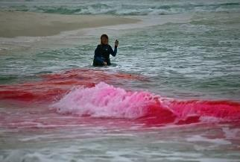
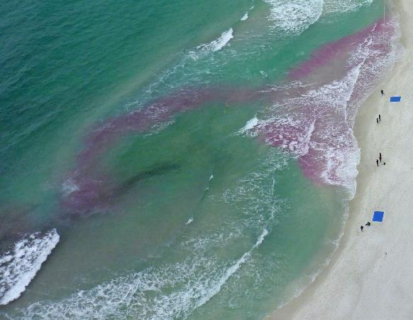
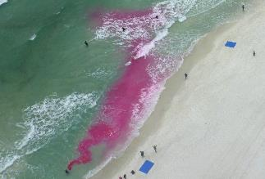
Nearshore Experiment
Notes:
Although the research emphasis is on oil spills and impacts, we are learning a lot of other things. The same group that did the drifter study out in the Gulf also carried out an experiment to study shoreline water movement (SCOPE). This is one of the best visual chronologies of a rip current generated by Longshore drift and inshore wave action. No doubt many of you are aware of the multiple deaths occur along the northern Gulf Coast and our other U.S. beaches each year due to swimmers being caught up in these anomalous currents.
Note that the last image shows the termination of the current a few tens of meters offshore and actually shows the current swings back in towards the beach. Images like this could help swimmers better understand how to behave and react when they get caught up in a rip current.

Slide 12
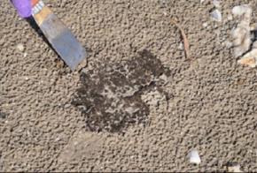
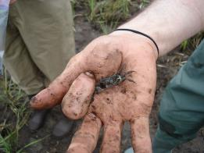
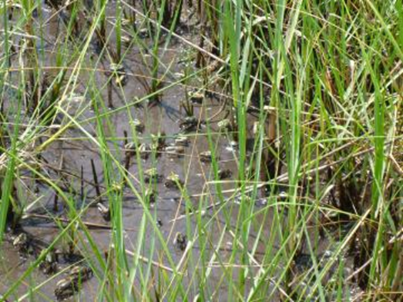
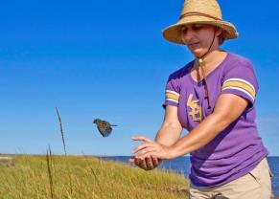
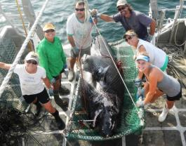
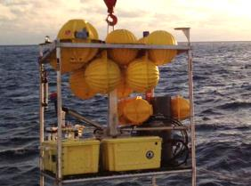
Oil Fate in Land and Sea
Notes:
NOTE: do we want to continue to call out individual scientists’ names – if so, need to be consistent…sometimes names are given, other times not.
Here a few pictures provided by GoMRI consortia illustrating some of the other things that we are studying
Many of our coastal residents were on the beaches during and following the oil spill and saw images like the one on the top left which was an oil soaked sand Patty partially covered by sand. Deep-C consortium has been studying the chemistry of the decomposition of oil and how it changes over time in these patties.
The CWC consortium based at LUMCON is studying oil impacts on marsh and associated fauna like fiddler crabs and periwinkle snails, birds and spiders. They are working in heavily oiled study sites and more pristine sites. Another very good example of enhanced research value is work on a seaside sparrow community; not only are researchers finding some concerning impacts on this avian community, but also they are contributing to the life history database on the species as it is relatively understudied.
Deep C consortium researchers are studying the biological and physical linages between the deep Gulf and Florida Shelf related to the oil spill. They caught this a whopping 12-foot Greenland shark from 6,000 feet below the surface of the Gulf of Mexico, unusually warm waters for the cold-water shark, and only the second such a catch from the GOM.
Another research consortia based at the University of Mississippi has developed these seafloor landers to place on the bottom to collect a variety of different data associated with particle movement across the seafloor with emphasis on petroleum and dispersants.
In our smaller research groups are conducting a variety of different types of projects, many of which are ecosystem focused, including the fate and transport of weathered oil, ecosystem impacts of oil spills on nekton, benthic organisms and marshes; one project is working on developing improved dispersants; three studies revolve around important commercial and recreational species of fish and crabs looking primarily at larval and juvenile stages which are more vulnerable to impact; several studies are looking at effects of oil spills
as well including a stem cell research project focusing on obeasagens and projects are focusing on technological improvements for detecting oil spills as well as monitoring oil spills using satellites.

Slide 13
Gulf of Mexico Research Initiative Information & Data Cooperative
GRIIDC mission: to ensure a data and information legacy that promotes continual scientific discovery and public awareness of the Gulf of Mexico ecosystem.
GRIIDC maintains the scientific datasets resulting from GoMRI-funded research and assists researchers with data archiving and data interoperability among GoMRI and other datasets.
Notes:
A requirement in the master research agreement and an expectation of the research board is that all data collected as part of this program be made available to other researchers and archived for the future: scientific datasets and project information
As you can all imagine this is not a trivial undertaking as a will involve 10 years of data collection and a plethora of research results in addition to the baseline data that are collected that are typical of oceanographic surveys. To accomplish this we have set up a data collection management unit called GRIIDC based at the Hart Research Institute in Texas.
This data management group will work with all the scientists to develop appropriate metadata formats and advise in archiving data in federally funded or otherwise national archive centers.
BP has always maintained the expectation that all that data generated as a result of GoMRI funding be made available for public use and scrutiny.
This reflect back on this new era of big data that is upon us. The ability to collect and share geo-referenced information and the power of supercomputing allows us to mine these massive data sets for cross disciplinary purposes.

Slide 14
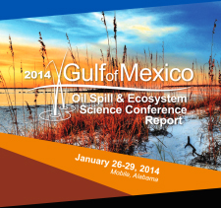
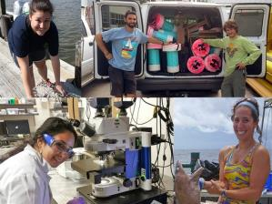
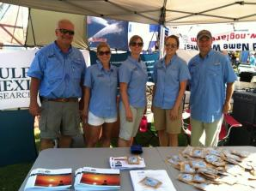
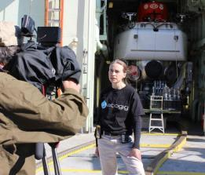
Education & Outreach
Next Generation Scientists
Science Conventions & Public Events
Website Stories, Newsletters, eNews
Media Events, Documentaries, Podcasts
Sea Grant, Smithsonian Ocean Portal, Screenscope
Notes:
In addition to having a very strong data management component, the research board has high expectations for outreach and education as part of the GoMRI program. Many of our consortia have active high school and college education programs and include aspiring young investigators in summer cruise and laboratory activities. In addition, consortia are participating in local seminar series, such as Rotary club, and set up displays at local festivals and media events on vessels with the goal of increasing public awareness of the research being funded and the results of those investments.
As part of this outreach effort we have recently engaged all four Gulf State Sea Grant programs to help us with the localized regional outreach efforts. The strategy here is to play specialist in each state that together provide a community of individuals that complement our research themes to help translate science for the consumers, and and bring back information from those consumers as to their view of research priorities and needs and concerns.
An additional element to our educational outreach effort includes a partnership with the Ocean Portal of the Smithsonian. They have a very active web interface that focuses on K-12 as well as the general public from around the United States. That web interface has a oil spill specific site that emerged out of the Deepwater horizon tragedy. Another outreach effort includes a partnership with Screenscope who is collecting video from researchers to help tell the story of GoMRI research.
One of the obvious legacy products of the GoMRI program will be its graduate students. We have touched over 600 students through involvement with GoMRI-funded projects. One of our goals is to build a community of practice around the students. We routinely have the project PIs identify outstanding GoMRI scholars who are students supported by GOMRI and have conducted GoMRI-focused research for at least one year. The scholars are recognized by the research board and our hope is to track them over the next 10 years to see the impact that the GoMRI investment has on graduate student education and job placement.

Slide 15
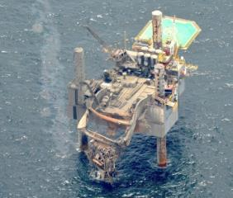
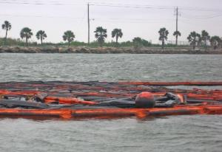
Collaborative Science Community
GoMRI Network of Scientists
Hercules Gas Blowout
Galveston Bay Oil Spill
Multi-Consortia Expert Teams
Hydrocarbon Inter-calibration Experiment
Marine Oil Snow and Sedimentation and Flocculate Accumulation Workshop
Dispersants Forum Workshop
Notes:
One of long-lasting and beneficial aspects of the GoMRI program – as well as having benefits now such as putting integrated science into immediate practice – is the breadth and depth of the science experts who have truly formed a community. As one of our consortia directors said after reflecting on their rapid response to the Hercules Gas Blowout: “Having GoMRI scientists on ‘speed dial’ created an efficient response network with the expertise to address important issues.”
Another PI said: “The GOMRI network – knowing the expertise of other GoMRI consortia and the proper people to contact – made it possible to assemble a scientific ‘dream team’ in short order. It was impressive to see how eager and willing our GoMRI colleagues were to contribute and become involved in this effort.”
And another: “The established GoMRI consortia made us all aware of the different expertise that consortia members have, making it easy to find the right people who are primed to contribute to a rapid response collaborative project.”
In response to the Galveston Bay oil spill, one responding PI said that all of the researchers who responded discussed how being a part of a larger, well-funded science community has enabled them to learn more in a shorter time period. And felt certain that he and his colleagues would not have been able to “cut through the red tape” of bureaucracy and get permission to sample in a timely manner without being a part of an organization like GoMRI.
HIE - (GoMRI) in cooperation with the National Institute of Standards and Technology (NIST) has launched the Hydrocarbon Inter-calibration Experiment (HIE) to address the need for advancing the importance of laboratory Quality Assurance/Quality Control (QAQC) practices and for inter-laboratory comparison and calibration for petroleum compounds. The purpose of this experiment is to facilitate the best science possible on hydrocarbon analysis, through improved refinement of reference analytics and levels.
MOSSFA- individual groups and multi-consortia teams – are finding that a significant quantity of the oil is located in deep and shelf sediments, likely associated with a marine snow event that caused a dramatic increase in sediment accumulation and oiling on the open ocean seafloor. As a collaborative team, they are beginning to build a comprehensive picture of the events during and after the spill, working to understand the processes leading to their formation, sinking and subsequent fate and impact on pelagic and benthic ecosystems. Prior to this, increased sedimentation was not considered as a pathway for oil in past response strategies and is not included in the current oil budget calculator for this oil spill. Efforts are underway to include these processes in models and in future response tools.
Dispersant workshop: The GoMRI Research Board, as part of the 2014 Gulf of Mexico Oil Spill & Ecosystem Science Conference, convened a Forum to discuss the current understanding of dispersants and their use and application following the Deepwater Horizon oil spill. Information presented included what was known about dispersants before the spill, what was learned from that will inform future dispersant application, what data gaps and concerns exist, and what future needs exist for developing and applying dispersants. The forum also considered new frontiers from related fields that could improve dispersants and its application. The Research Board will use the outcomes from this forum to inform future gatherings on the research needed on dispersants and the information needed to inform policy and management decision about when and how to use dispersants during spills.

Slide 16
